Slide 1
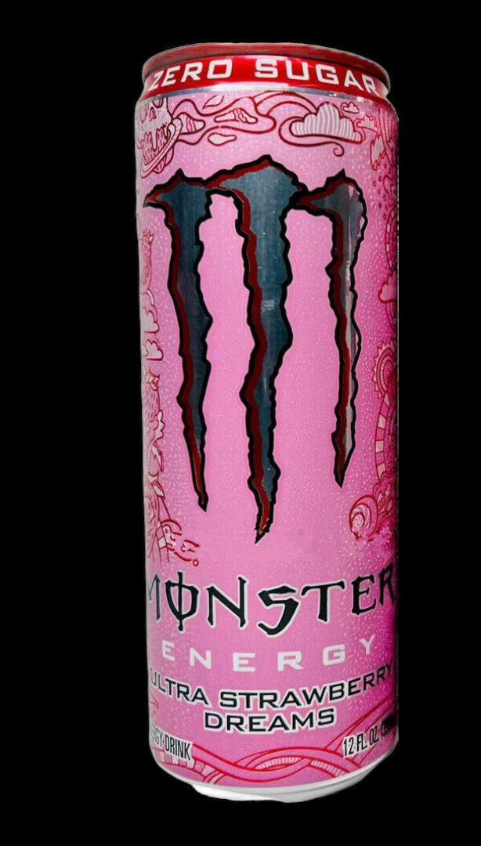
Monster Energy:
Color Classification &
Text Recognition
AA 2024/2025
Signal, Image & Video
Elia Avanzolini, Alejandro Enrique Barbi, Martina Panini

Slide 2
Aim of the project
🎯 Goal:
Develop an automated classifier for Monster Energy cans by the use of Computer Vision techniques
📌 How: Identify in images the kinds of Monster Energy cans based on color and text
🧭 Steps:
✔️ Draw Bounding-Box ✔️ Pre-Processing images
✔️Perform Color classification and Text Recognition

Slide 3
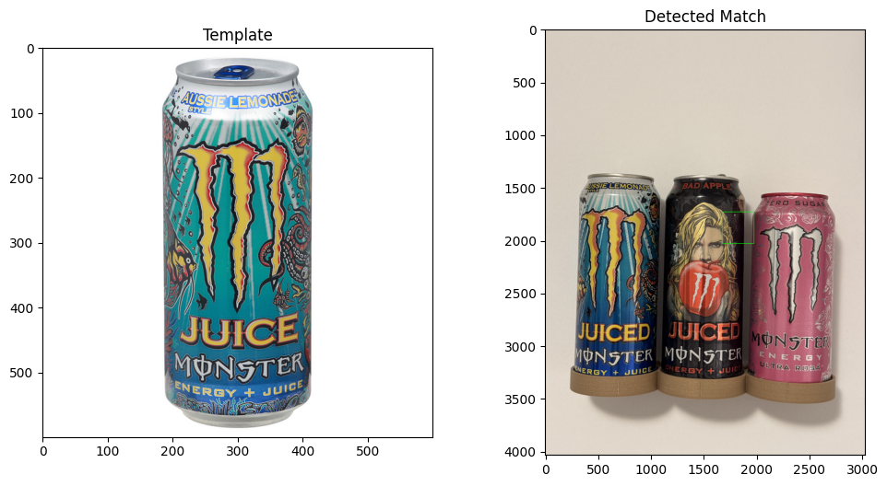
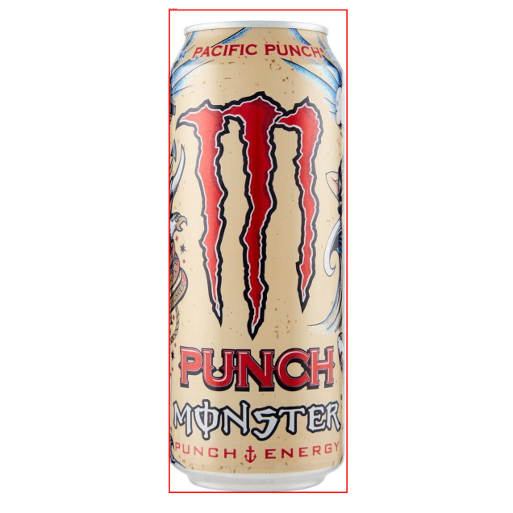
More in details
Bounding Box
Template-Matching
Pre-Trained Model
Use of an OpenCV function, Template-Matching to try to draw bounding box.
Try to find the can in the images based on a provided template.
Use of a Deep Learning pre-trained model to draw bounding box in complex case scenario, where Template-Matching produces unsatisfactory result.

Slide 4
More in details
Classification & Recognition
Color
Text
Key features are extracted from images and processed, before being fed into a Multi-Layer Perceptron (MLP) for classify color.
Employ EasyOCR module to detect brand name and flavour name by extracting text.
Use of preprocessing on images to make text clearer.

Slide 5
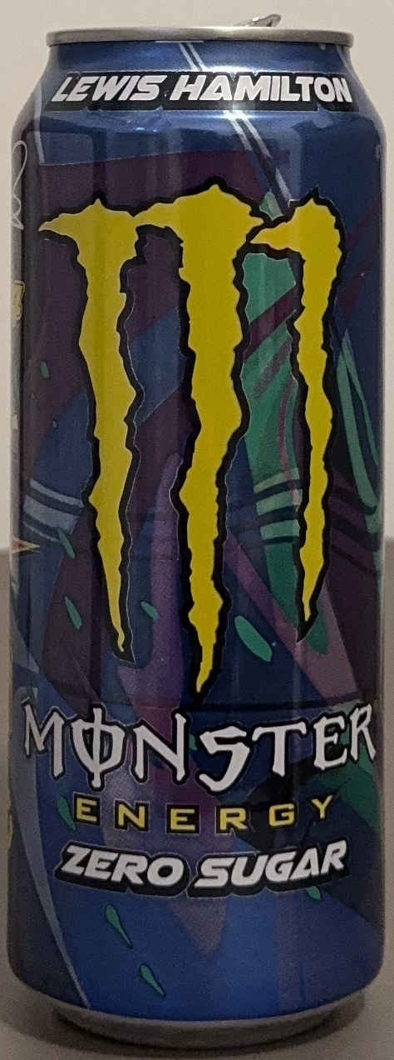
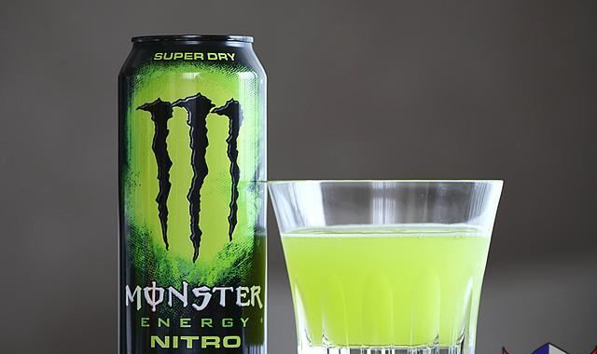
Dataset
Images of cans. We take an online dataset, enriched by some other photos captured by us.
Kaggle
Captured
Dataset taken from Kaggle, composed of 19 classes.
Images are user-generated.
Pro: Great Variety
Contro: Difficult drawing bounding box
We take some photos to augment dataset size and variety. In addiction we use even some picture to test the model.

Slide 6
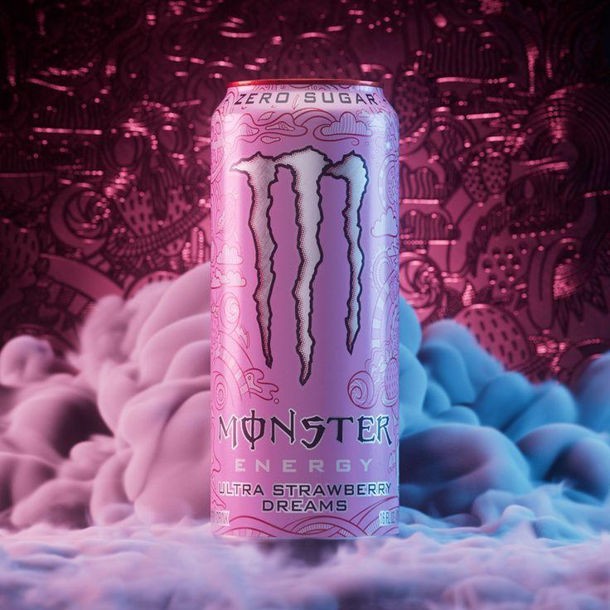
Methodology
Methodology
Template-Matching
Pre-Processing
Color Classification
Text Recognition

Slide 7
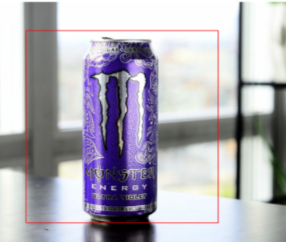
Template-Matching
Used of an OpenCV function, called Template-Matching. Combine with angle and size adjustment to increase robustness.
Example of Bounding Box
Thanks to Bounding Box we used only the cans to extract features.
Three methods used:
Normalized Correlation Coefficient
Normalized Cross-Correlation
Normalized Sum of Square Differences

Slide 8
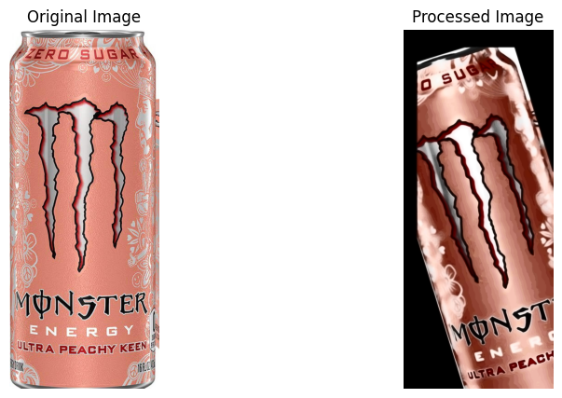
Pre-Processing
Before feature extraction, images are pre-processed. Pipeline includes:
1.
Horizontal Flipping
2.
Rotation and Scaling
3.
Translation
4.
Contrast and Brightness Changes
5.
Gaussian Blur and Denoising
6.
Histogram Equalization

Slide 9
Classification & Recognition
Color
Model Training
Data Standardization & Label Encoding
The extracted features are standardized. Can labels are encoded preparing them for the model
The classification is handled by a Multi-layer Perceptron (MLP) classifier, configured with two hidden layers and ReLU as activation function..
Classification
Evaluation
After training, the model is used to classify new images based on their color features.
The model’s performance is evaluated using accuracy metrics and classification reports.

Slide 10
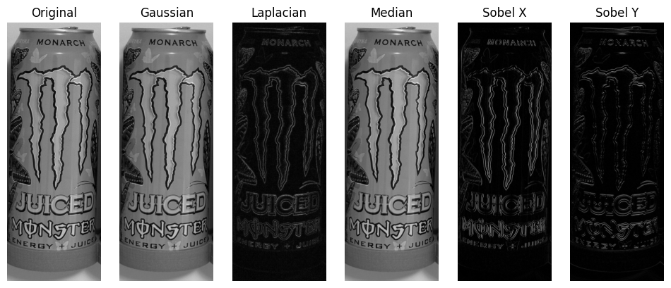
Classification & Recognition
Text
Grayscale & Binarization Conversion
Gaussian & Median FIlter
The preprocessing begins with converting images to grayscale, followed by binarization to increase contrast and make text clearer.
Gaussian Blur is used to smooth image and, together with median filter, help to reduce noise, preserving text structure .
Laplacian &
Sobel Filter
EasyOCR
Use to detect and enhance edges, improving the distinction of text from background.
Apply EasyOCR to the region of interest to detect text. Furthermore text with low confidence score is removed.

Slide 11
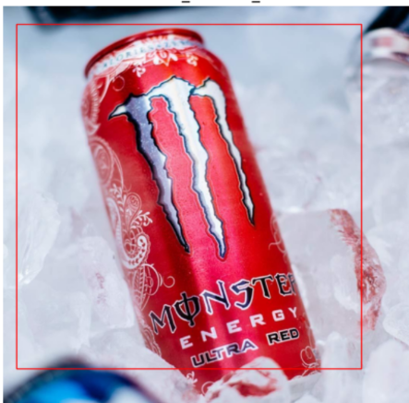
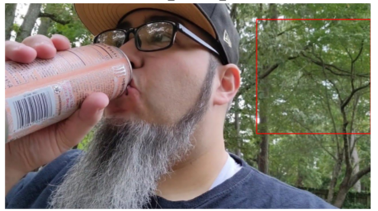
Results
Bounding Box
Template matching goes from discreet results…
…to very bad ones

Slide 12
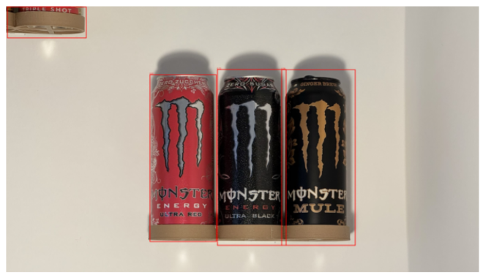
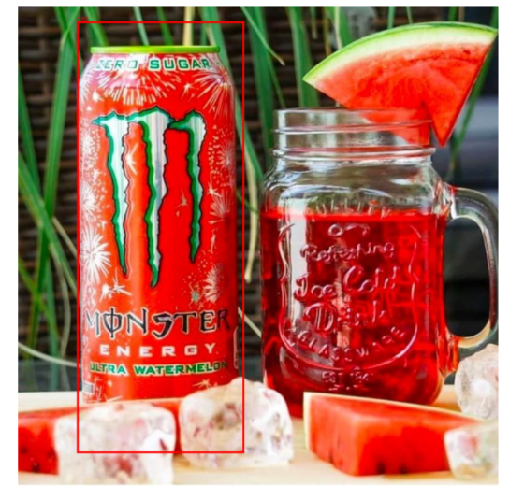
Results
Even in the hardest scenarios
Bounding Box
While the pre-trained model works very well in all cases

Slide 13
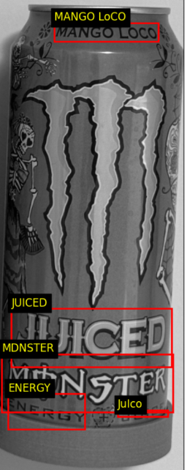
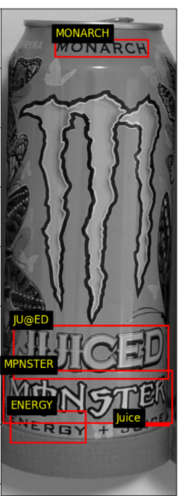
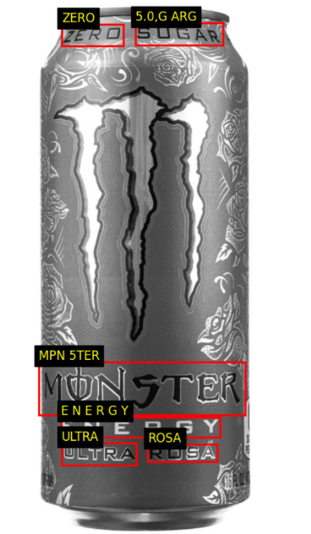
Results
Text Recognition
Some satisfactory results obtained by text recognition

Slide 14
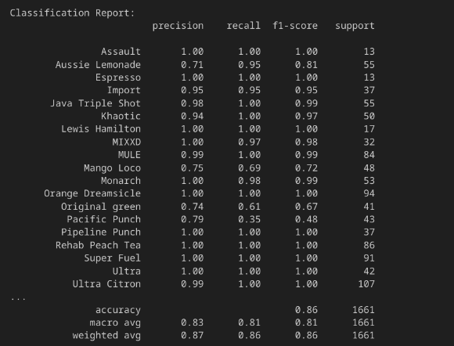
Results
Color Classification
Classification on color works pretty well.
Unfortunately, classes with lower representation in the dataset tend to be classified with lower accuracy compared to the more represented classes.

Slide 15
Conclusion
Bounding Box
Template Matching struggles in bounding boxes detection in complex-case scenarios.
Size and rotation adjustment, along pre-processing, can partially resolve issues, but are not sufficient to match results similar to the pre-trained model.
Classification
Both color and text recognition works well in some cases but poorly in others.
Overall they provide enough capabilities to perform a correct classification on Monster cans.

Slide 16
Q&A
Thanks for your attention!
Any Questions?
Avanzolini Elia
Barbi Alejandro Enrique
Panini Martina

Slide 17
TAKE AWAY
or What I learned from this project

Slide 18
